Slide 1


W
A
B
C
v
D
U
F
T
G
S
H
R
I
P
N
J
M
L
K

Slide 2
Protection for animals’ hooves.
Horseshoe

Slide 3
Court created by the Church to fight anti-Christian movements and judge crimes against faith.
Inquisition

Slide 4
Part of the Land left uncultivated
Fallow

Slide 5
Building that housed the City Council.
Town Hall

Slide 6
Mother of Jesus Christ.
Virgin

Slide 7
Military expeditions convened by the Pope to expel the Muslims from the Holy Land.
Crusades

Slide 8
Craftsman who is unpaid while learning the trade.
Apprentice

Slide 9
Teaching methods used at university consisting of reading a text, raising a problem, discussing it and taking a decision.
Scholastics

Slide 10
Machine whose power is provided by a wheel that is turned by moving water.
Watermill

Slide 11
Neighbourhoods of craftsmen and merchants.
Borough

Slide 12
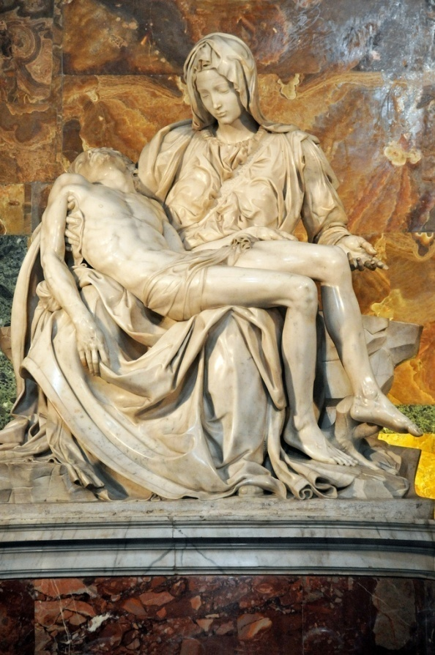
Artistic representation of the Virgin holding Christ’s corpse.
Pietà

Slide 13
Mendicant order created by the church to intensify preaching in the cities.
Dominicans

Slide 14
Magistrates of the city government who held executive power
Mayor

Slide 15
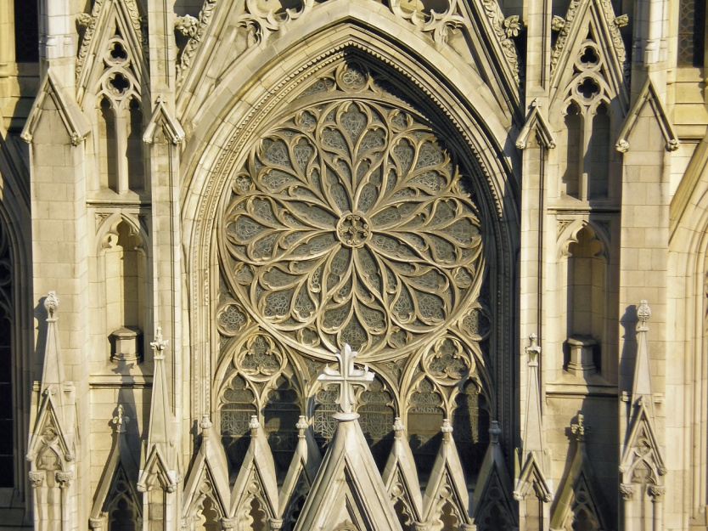
Round flower design used in architecture to decorate the facades of cathedrals.
Rosette

Slide 16
Association of artisans of the same trade
Guild

Slide 17
Stage prior to master craftsman who got a salary for his job.
Journeyman

Slide 18
One of the four specializations that university studies offered
Law

Slide 19
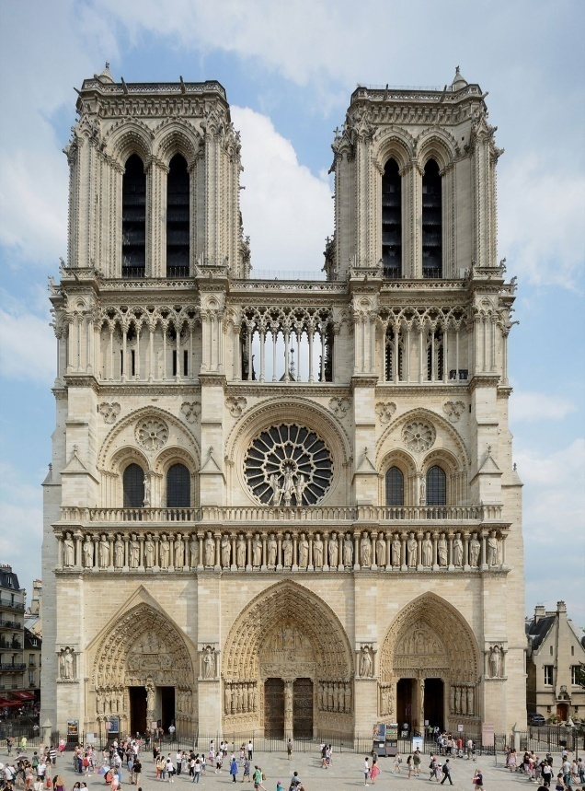
Example of Gothic Cathedral in Paris
Notre Dame

Slide 20
Pope who summoned the first crusade.
Urban II

Slide 21
Military Order in charge of protecting Christian Pilgrims who came to visit the Holy Place.
Knights Templar

