Slide 1
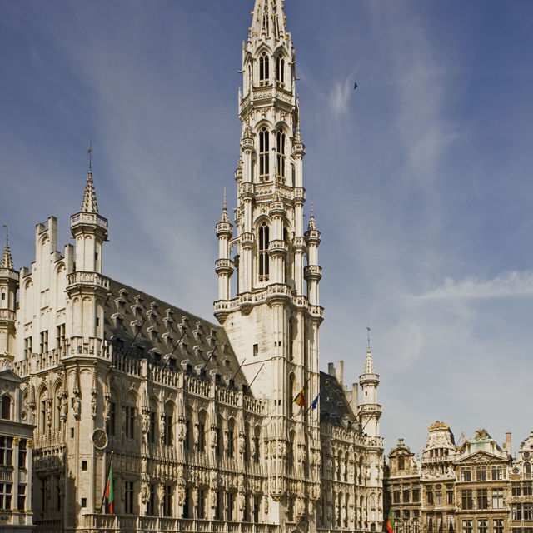
THE LATE MIDDLE AGES. CRISIS AND RECOVERY
Match the colour paragraphs and the images

Slide 2
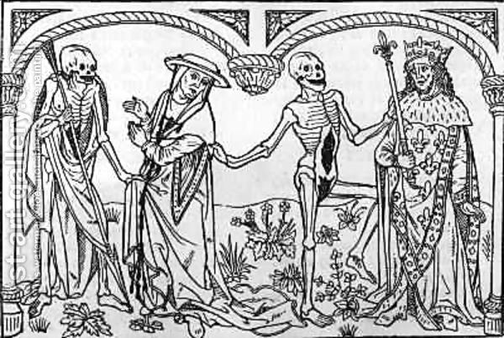
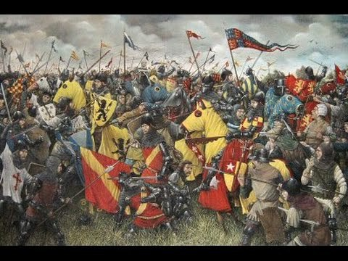

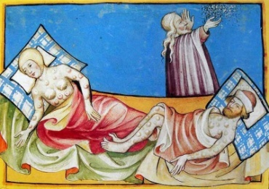
The Late Middle Ages covers the 14th and 15th centuries. The 14th century is characterised as a period of crisis and the 15th century is generally viewed as a period of recovery.
CAUSES OF THE CRISIS. The 14th century crisis was mainly due to wars, the plague and famine.
The longest war in Europe was the Hundred Years War, which opposed France to England.
In the Peninsular Christian kingdoms, feudal lords fought against other feudal lords or against the king.
The most devastating plague, the Black Death, was brought to Europe from Asia though the trade routes.
Famine occurred as a consequence of loss of harvests after successive years of heavy rain.
CONSEQUENCES OF THE CRISIS.
The European population fell to almost half in just one century (from 1300 to 1400).
Reduced agricultural production and handicrafts led to a decline of economy.
Social conflicts increased in the cities and in rural areas.
Art expressed pessimism in macabre ways.
RECOVERY IN THE 15TH CENTURY.
Kings prevailed over the feudal lords.
The population began to grow.
Crafts and agriculture were recovered.
Trade was revived.
Social peace was restored.
a
1
b
2
3
c
4
d

Slide 3
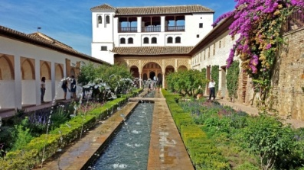
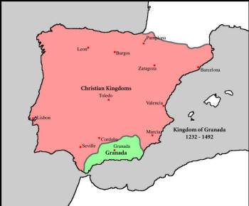
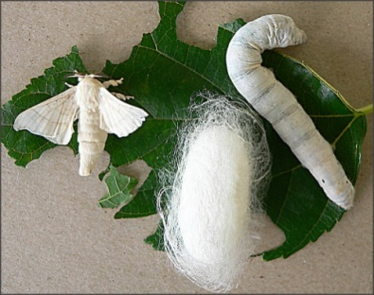
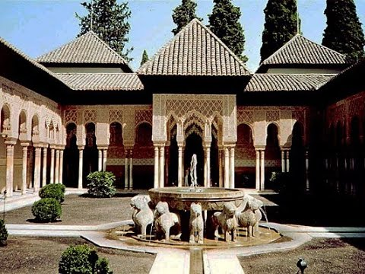
THE NASRID KINGDOM OF GRANADA
The only Muslim Kingdom in the Peninsula, survived until 1492 thanks to its geographic location south of Sierra Nevada, and negotiations of peace with Castilla in exchange for parias, contributed to its stability.
Constant political conflicts in the Nasrid Kingdom made Christians conquer small territories.
The economy splendour was the result of the expansion of irrigation, mining and textile handicrafts, especially silk, along with trade with Muslim Africa, peninsular kingdoms and the rest of Europe.
NASRID ART
The most significant architectural work was the Alhambra in Granada, which consisted of:
The Alcazaba, a fortress which comprised walls and defence towers, was connected to the Generalife, the recreational estate with gardens.
The Royal Complex includes 2 palaces consisting of rooms set around courtyards with fountains and gardens. The Comares Palace was the public area and the Court of the Lions was the private area, where the Harem and the private quarters of the Caliph were established.
The palatine city was the administrative district with houses, mosques, public baths and a cemetery.
CHRISTIAN KINGDOMS: POLITICAL TENSIONS AND EXPANSION.
In spite of the conflicts that struck the four peninsular Christian kingdoms of Castilla, Aragón, Navarra and Portugal, Castilla and Aragon continued their territorial expansion.
Political tensions began when the kings tried to recover political power by revoking that of the manors and cities, so they created hearings to administer justice, improved tax collections and confronted the nobility.
1
a
2
b
3
c
4
d

Slide 4
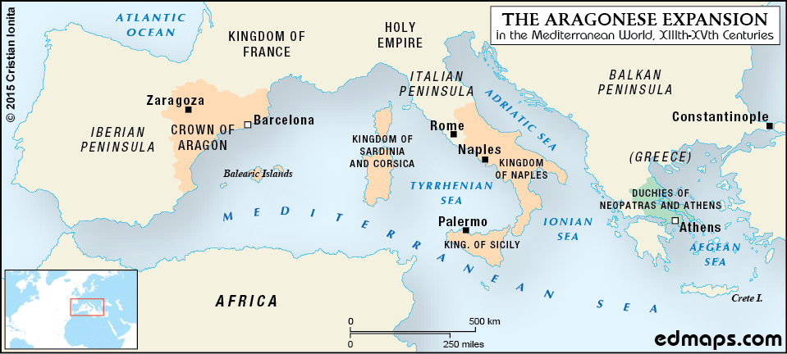
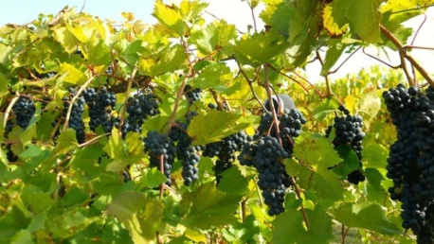
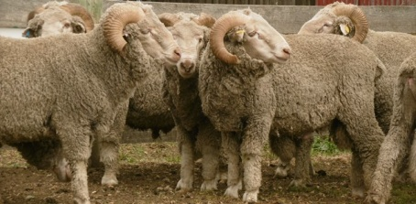
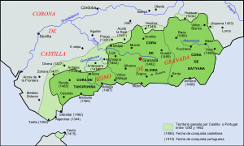
CASTILLA
Alfonso XI ruled under a common legislation for the entire kingdom, and imposed himself to the nobility. However, his son, Pedro I, found the strong opposition of the nobility, who supported his illegitimate brother, crowned as Enrique II, giving way to the new dynasty of the Trastámara.
Castilla began its Atlantic expansion and took control of the Straits of Gibraltar, Tarifa, Algeciras, Gibraltar and the Canary Islands.
ARAGÓN AND CASTILLA
In the Kingdom of Aragon, the kings had to make concessions to the nobility and the Courts in exchange for money, and a Generalitat was created to monitor that the agreements of the courts were fulfilled.
In 1412, Fernando de Antequera was elected king.
The Kingdom of Aragón continued its Mediterranean expansion by taking the duchies of Athens, Neopatria, Sardina and the south of Italy where the Kingdom of Naples was founded.
Navarra became independent from France and the kings had to accept the power of the nobility and the Courts of Navarra.
CHRISTIAN KINGDOMS ECONOMY
AGRICULTURE:
In the 14th century agricultural production fell and rural areas were depopulated. However, livestock farming increased and wool exports provided huge revenues.
In the 15th century cereal production recovered and cash crops were developed in Castilla and garden crops and dye plants were developed in Aragón.
a
1
b
c
2
d
3
4

Slide 5

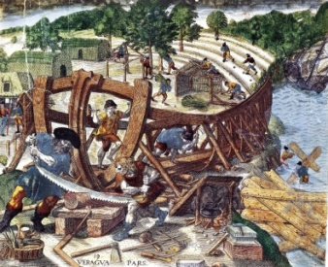
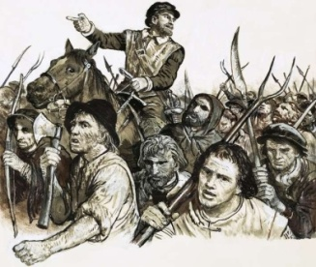
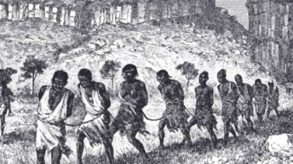
CRAFTS
Crafts went into crisis during the 14th century due to the decline in demand and recovered when the population started to grow.
The textile sector was very important. In Castilla, coarse cloth was produced in Toledo, Palencia and Cuenca. In Aragón, the major textile industries were set in Barcelona and Valencia.
Other important handicrafts sectors were the ironworks of Vizcaya and Guipuzkoa, and shipbuilding in Sevilla and Barcelona.
TRADE
Foreign trade wasn’t seriously affected by the 14th century crisis.
In Castilla, the Cantabrian ports exported wool, oil, wine and iron to England and Flanders and imported quality cloth and luxury items. The ports in western Andalusia exported agricultural products, metals, leather and dyes and imported Italian fabrics and spices.
In Aragón, traders exported food and textiles and imported silk, spices, gold and slaves.
Trading gave rise to the creation of public credit institutions.
THE SOCIAL STATES AND SOCIAL TENSIONS
In the 14th century, European and peninsular monarchs granted great concessions to the nobles in exchange for their support. The clergy also retained their economic power as long as they supported the kings and the commoners revolted against those holding power in rural and urban areas.
In the 15th century, social tensions decreased in Europe, but there were still serious conflicts on the Peninsula.
Most rural revolts were because lords wanted to compensate their losses by making higher demands on peasants. On the Peninsula, the most remarkable uprisings took place in Irmandiños (Galicia), in Catalonia and in Mallorca.
Tensions in the cities confronted the commoners and the urban oligarchy or aristocracy, who monopolised power and wealth and controlled urban government. On the Peninsula, revolts were led by impoverished craftsmen, who fought lords or wealthy merchants.
a
1
2
b
3
c
d
4

Slide 6
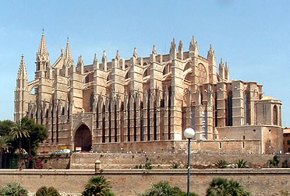
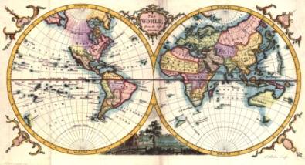
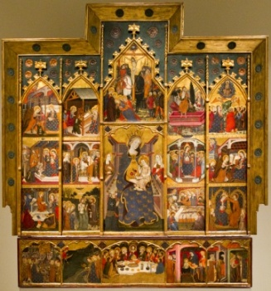
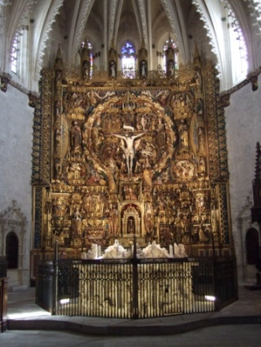
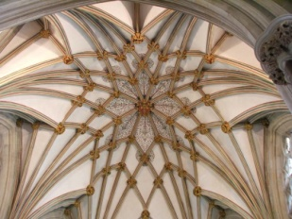
CULTURE AND ART
In the 14th century, death became the trending topic in Literature, as shown in the Decameron by Boccaccio and the Canterbury Tales by Chaucer. On the Peninsula, remarkable genres were popular (Romancero) or aristocratic poetry (Marqués de Santillana), books of chivalry (Amadis de Gaula) or narrative works (The Book of Good Love).
Science did not develop much, but Cartography progressed thanks to the creation of portulan maps.
Sculpture was mainly developed in the form of altarpieces of wood or alabaster, and marble or alabaster tombs. Peninsular altarpieces of the Miraflowers Charterhouse and the Cathedral of Tarragona stand out.
In the 14th century painting , the Italian School of Siena exerted strong influence on Catalan painters like Ferrer Bassa and Pere and Jaume Serra. In the 15th century, the International Gothic featured elegant and refined figures, greater attention to detail and architectonic backgrounds.
Gothic architecture in the 14th and 15th centuries added new features to the prevailing style, which gave rise to the Mediterranean Gothic and the Flamboyant Gothic.
  Mediterranean Gothic developed in Italy, Southern France and the Kingdom of Aragón. The churches had a single nave or three naves with similar height and no transept. On the exterior there were very few flying buttresses, thick buttresses, few openings and very little decoration. Examples of these are the Cathedrals of Florence and Siena in Italy and those of Barcelona and Palma on the Peninsula.
  Flamboyant Gothic was highly decorated with the ogee and basket-handle arches and fan and star-shaped vaults. The towers topped with pointed spires and fretwork. We can find some examples of these in the Gloucester Cathedral, the City Halls of Bruges and Brussels and some chapels in the cathedrals of Burgos and Murcia.
a
b
1
2
c
3
4
d
5
e

